Slide 1

Static & Dynamic web pages, JSP

Slide 2


Course : Backend
Lecture On : Static & Dynamic web pages, Servlet and JSP
Instructor :

Slide 3
Today’s Agenda
Static and Dynamic web pages
JSP
Introduction to Maven
Creating first app

Slide 4
Static and Dynamic web pages
Static Web pages:
Static Web pages are very simple. It is written in languages such as HTML, JavaScript, CSS, etc.
For static web pages when a server receives a request for a web page, then the server sends the response to the client without doing any additional process. T
hese web pages are seen through a web browser.
In static web pages, Pages will remain the same until someone changes it manually.
Static web pages are called websites
Dynamic Web Pages:
Dynamic Web Pages are written in languages such as CGI, AJAX, ASP, ASP.NET, etc.
In dynamic web pages, the Content of pages is different for different visitors.
It takes more time to load than the static web page.
Dynamic web pages are used where the information is changed frequently, for example, stock prices, weather information, etc.
Dynamic web pages are called web applications

Slide 5
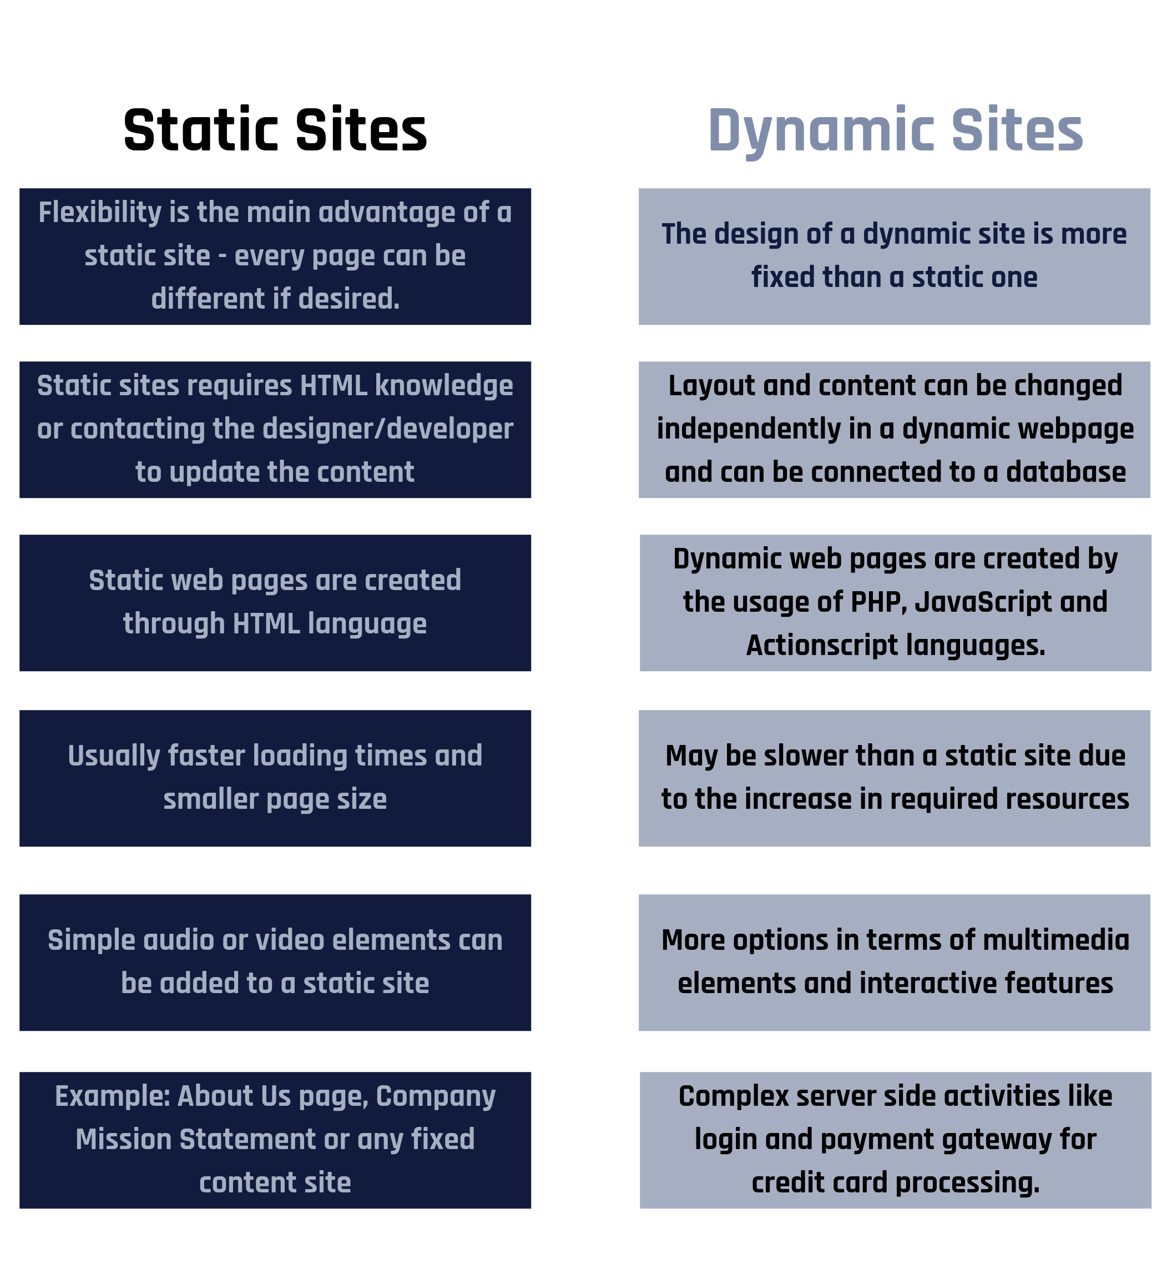
Static and Dynamic web pages

Slide 6
What is JSP?
JSP technology is used to create web application just like Servlet technology.
It can be thought of as an extension to Servlet because it provides more functionality than servlet such as expression language, JSTL, etc.
A JSP page consists of HTML tags and JSP tags.
The JSP pages are easier to maintain than Servlet because we can separate designing and development.
It provides some additional features such as Expression Language, Custom Tags, etc.

Slide 7
What is JSP?
It is a server side technology.
It is used for creating web application.
It is used to create dynamic web content.
In this JSP tags are used to insert JAVA code into HTML pages.
It is an advanced version of Servlet Technology.
It is a Web based technology helps us to create dynamic and platform independent web pages.
In this, Java code can be inserted in HTML/ XML pages or both.
JSP is first converted into servlet by JSP container before processing the client’s request.

Slide 8
Why JSP is better than Servlet?
JSP pages are more advantageous than Servlet:
They are easy to maintain.
No recompilation or redeployment is required.
JSP has access to entire API of JAVA .
JSP are extended version of Servlet.

Slide 9
Life Cycle of JSP pages
The JSP pages follow these phases:
Translation of JSP Page
Compilation of JSP Page
Classloading (the classloader loads class file)
Instantiation (Object of the Generated Servlet is created).
Initialization ( the container invokes jspInit() method).
Request processing ( the container invokes _jspService() method).
Destroy ( the container invokes jspDestroy() method).
Note: jspInit(), _jspService() and jspDestroy() are the life cycle methods of JSP.

Slide 10
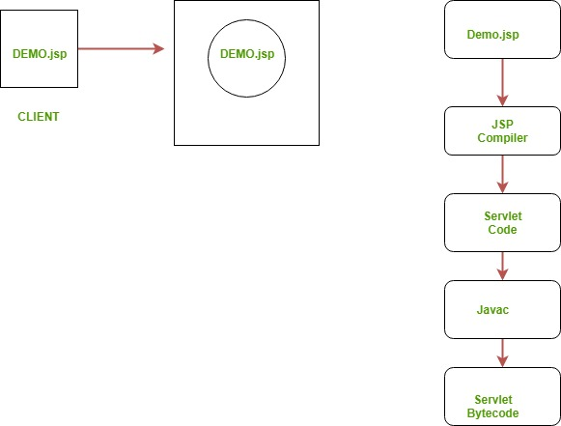
Life Cycle of JSP pages

Slide 11
JSP Syntax
Syntax available in JSP are following
Declaration Tag :- It is used to declare variables.
Syntax:-
<%! Dec var %>
Example:-
<%! int var=10; %>
Java Scriplets :- It allows us to add any number of JAVA code, variables and expressions.
Syntax:-
<% java code %>

Slide 12
JSP Syntax
JSP Expression :- It evaluates and convert the expression to a string.
Syntax:-
<%= expression %>
Example:-
<% num1 = num1+num2 %>
JAVA Comments :- It contains the text that is added for information which has to be ignored.
Syntax:-
<% -- JSP Comments %>

Slide 13
Introduction to Maven
Apache Maven is a software project management and comprehension tool. Based on the concept of a project object model (POM), Maven can manage a project's build, reporting and documentation from a central piece of information.
Why and how Maven project started?
Maven, a Yiddish word meaning accumulator of knowledge, began as an attempt to simplify the build processes in the Jakarta Turbine project.
There were several projects, each with their own Ant build files, that were all slightly different. JARs were checked into CVS.
Jakarta project team wanted a standard way to build the projects, a clear definition of what the project consisted of, an easy way to publish project information, and a way to share JARs across several projects.
Maven’s objectives
Maven’s primary goal is to allow a developer to comprehend the complete state of a development effort in the shortest period of time. In order to attain this goal, Maven deals with several areas of concern:
Making the build process easy
Providing a uniform build system
Providing quality project information
Encouraging better development practices

Slide 14
Introduction to Maven
Apache Maven is a software project management and comprehension tool. Based on the concept of a project object model (POM), Maven can manage a project's build, reporting and documentation from a central piece of information.
Why and how Maven project started?
Maven, a Yiddish word meaning accumulator of knowledge, began as an attempt to simplify the build processes in the Jakarta Turbine project.
There were several projects, each with their own Ant build files, that were all slightly different. JARs were checked into CVS.
Jakarta project team wanted a standard way to build the projects, a clear definition of what the project consisted of, an easy way to publish project information, and a way to share JARs across several projects.
Maven’s objectives
Maven’s primary goal is to allow a developer to comprehend the complete state of a development effort in the shortest period of time. In order to attain this goal, Maven deals with several areas of concern:
Making the build process easy
Providing a uniform build system
Providing quality project information
Encouraging better development practices

Slide 15
Introduction to Maven : Maven’s objectives
Making the build process easy
While using Maven doesn’t eliminate the need to know about the underlying mechanisms, Maven does shield developers from many details.
Providing a uniform build system
Maven builds a project using its project object model (POM) and a set of plugins. Once you familiarize yourself with one Maven project, you know how all Maven projects build. This saves time when navigating many projects.
Providing quality project information
Maven provides useful project information that is in part taken from your POM and in part generated from your project’s sources. For example, Maven can provide:
Change log created directly from source control
Cross referenced sources
Mailing lists managed by the project
Dependencies used by the project
Unit test reports including coverage
Third party code analysis products also provide Maven plugins that add their reports to the standard information given by Maven.

Slide 16
Introduction to Maven : Maven’s objectives
Providing guidelines for best practices development
Maven aims to gather current principles for best practices development and make it easy to guide a project in that direction.
For example, specification, execution, and reporting of unit tests are part of the normal build cycle using Maven. Current unit testing best practices were used as guidelines:
Keeping test source code in a separate, but parallel source tree
Using test case naming conventions to locate and execute tests
Having test cases setup their environment instead of customizing the build for test preparation
Maven also assists in project workflow such as release and issue management.
Maven also suggests some guidelines on how to layout your project’s directory structure. Once you learn the layout, you can easily navigate other projects that use Maven.

Slide 17
Introduction to Maven : pom.xml
●Maven resolves dependencies via a POM.xml file.
●This is a file where the developer, i.e., you, will mention all the other code and libraries that your program will be dependent upon.
●There are some third-party libraries with pre-written code that you can use and install in your project.
●You just need to refer the same in the POM file such that Maven downloads all these pre-written Java codes in the form of JARs.
Example :
<project>
<modelVersion>4.0.0</modelVersion>
<parent>
<groupId>com.mycompany.app</groupId>
<artifactId>my-app</artifactId>
<version>1</version>
</parent>
<groupId>com.mycompany.app</groupId>
<artifactId>my-module</artifactId>
<version>1</version>
</project>

Slide 18
What is JSP?
It is a server side technology.
It is used for creating web application.
It is used to create dynamic web content.
In this JSP tags are used to insert JAVA code into HTML pages.
It is an advanced version of Servlet Technology.
It is a Web based technology helps us to create dynamic and platform independent web pages.
In this, Java code can be inserted in HTML/ XML pages or both.
JSP is first converted into servlet by JSP container before processing the client’s request.

Slide 19
Life Cycle of JSP pages
The JSP pages follow these phases:
Translation of JSP Page
Compilation of JSP Page
Classloading (the classloader loads class file)
Instantiation (Object of the Generated Servlet is created).
Initialization ( the container invokes jspInit() method).
Request processing ( the container invokes _jspService() method).
Destroy ( the container invokes jspDestroy() method).
Note: jspInit(), _jspService() and jspDestroy() are the life cycle methods of JSP.

Slide 20
Life Cycle of JSP pages

Slide 21
JSP Syntax
Syntax available in JSP are following
Declaration Tag :- It is used to declare variables.
Syntax:-
<%! Dec var %>
Example:-
<%! int var=10; %>
Java Scriplets :- It allows us to add any number of JAVA code, variables and expressions.
Syntax:-
<% java code %>

Slide 22
JSP Syntax
JSP Expression :- It evaluates and convert the expression to a string.
Syntax:-
<%= expression %>
Example:-
<% num1 = num1+num2 %>
JAVA Comments :- It contains the text that is added for information which has to be ignored.
Syntax:-
<% -- JSP Comments %>

Slide 23
Hello world application using JSP
For servlet hello world application refer to : https://github.com/Allah-The-Dev/java-spring-boot/tree/main/helloworld_servlet_jsp_spring
For JSP hello world application refer to : https://github.com/Allah-The-Dev/java-spring-boot/tree/main/helloworld_servlet_jsp_spring

Slide 24
#LifeKoKaroLift
Thank You!

